Slide 1

Facilitating the Integration of Borehole Thermal Energy Storage in District Energy Systems: Improving the Fidelity of Design Tools
Constantinos Paschalis
Website: https://constantinospaschalis.github.io/
Contact: con.paschalis@gmail.com
Supervisors: Professor Dr. André Bardow
Dr. Gabriele Humbert
Dr. Casati Emiliano
02 September 2026, Zurich

Slide 2
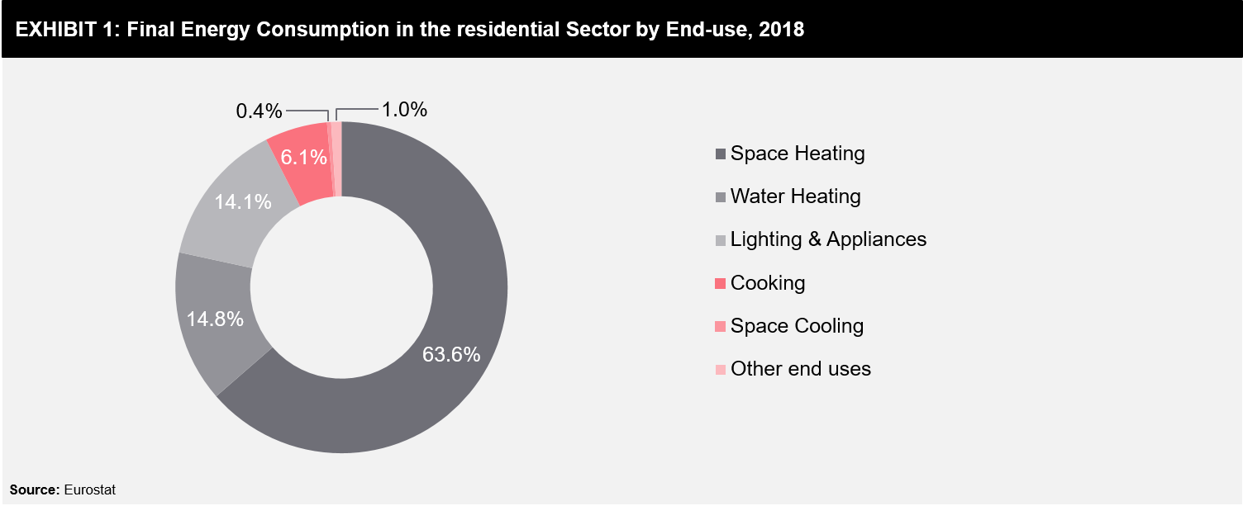


Motivation – Share of Renewables
In the EU 49.3% of net electricity generated comes from renewable energies¹
For heating and cooling only 26.1%¹
²
[1] https://ec.europa.eu/eurostat/statistics-explained/index.php?title=Renewable_energy_statistics
[2] https://www.futurebridge.com/industry/perspectives-energy/renewable-based-heating-and-cooling-in-europe-by-2030/
Notes:
77 percent of the resindential sector and roughly 50% of the total energy use

Slide 3
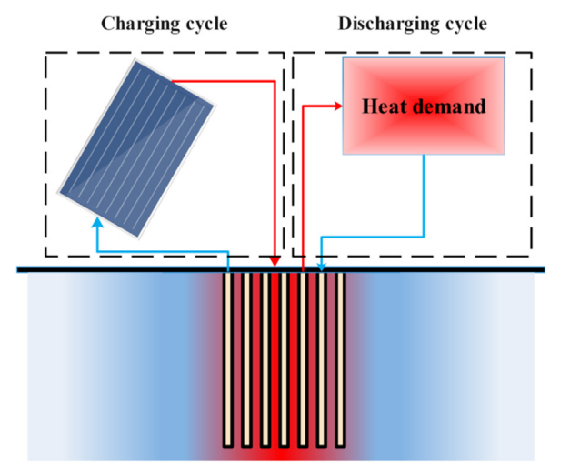
Why is Borehole Thermal
Energy Storage (BTES)?
BTES to contribute to the transition⁴
Utilize the ground as a thermal storage medium by injecting and extracting heat through the borehole heat exchangers⁵
Enable seasonal thermal energy storage, allowing surplus heat generated during one period of the year to be utilized at a later time⁶
BTES limitations
High initial investment
Large land requirement
Site-dependent performance
[3]
[3] Pourahmadiyan, A., Sadi, M., & Arabkoohsar, A. (2023). Seasonal Thermal Energy Storage. In A. Arabkoohsar (Ed.), Future Grid-Scale Energy Storage Solutions: Mechanical and Chemical Technologies and Principles (pp. 215–257)
[4] Mohammadamin Ahmadfard and Ehsan Baniasadi. Borehole thermal energy stor-age systems: A comprehensive review using bibliometric and qualitative tools.
[5] https://dewesoft.com/blog/solar-borehole-thermal-energy-storage
[6] Cynthia Ann Cruickshank and Christopher Baldwin. Sensible thermal energy storage:Diurnal and seasonal. In Storing Energy, pages 291–311. Elsevier.

Slide 4
State of the Art
Modern BTES Research
Overview of BTES operation⁷
MES sizing and operation optimization⁸
Existing literature does not clearly quantify:
Which parameters most affect BTES model fidelity
Whether simplified models remain suitable for system-level optimization
Trade-Off
High-Fidelity Models, e.g Modelica Models^{9,10}
  Used for operation modeling
  Better thermal representation
  Very high computational cost
Simplified Models, e.g. MINLP, MILP¹¹
  Sizing tools
  Faster optimization
  Reduced physical realism
[7] Manfred Reuss. The use of borehole thermal energy storage systems. In Advances inThermal Energy Storage Systems.
[8] Pierluigi Mancarella. MES (multi-energy systems): An overview of concepts andevaluation models
[9] Mohamed T. Bahr, Piyush Kumar Kumawat, Palash Panja, and Kody M. Powell. A dynamic 2d borehole thermal energy storage (BTES) model forenhanced computational efficiency.
[10] Mohamed T. Bahr, Ali Khosravani, Dynamicsimulation and economic evaluation of dual-mode borehole thermal energy storagein electrified district energy systems.
[11] Massimo Fiorentini, Philipp Heer, and Luca Baldini. Design optimization of a dis-trict heating and cooling system with a borehole seasonal thermal energy storage.

Slide 5
Research Idea – Research
Question
How different modeling assumptions influence the optimal design, operation, and computational performance of BTES-integrated energy systems?
Quantify how different operational assumptions influence technology sizing, system operation, annual system cost and computational performance?
How does the level of detail of the mathematical formulation affect the results?
Is the level of system complexity an important aspect of model selection?
Notes:
Tractability is the simple approach lost

Slide 6
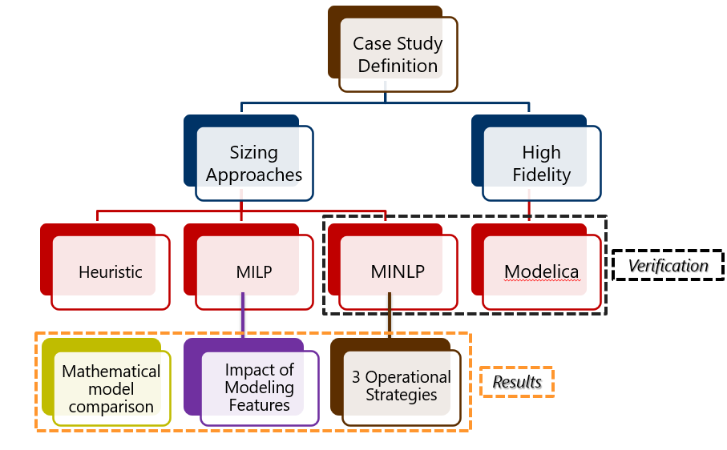
Research Idea
MILP: Mixed-Integer Linear Programming
MINLP: Mixed-Integer Nonlinear Programming

Slide 7
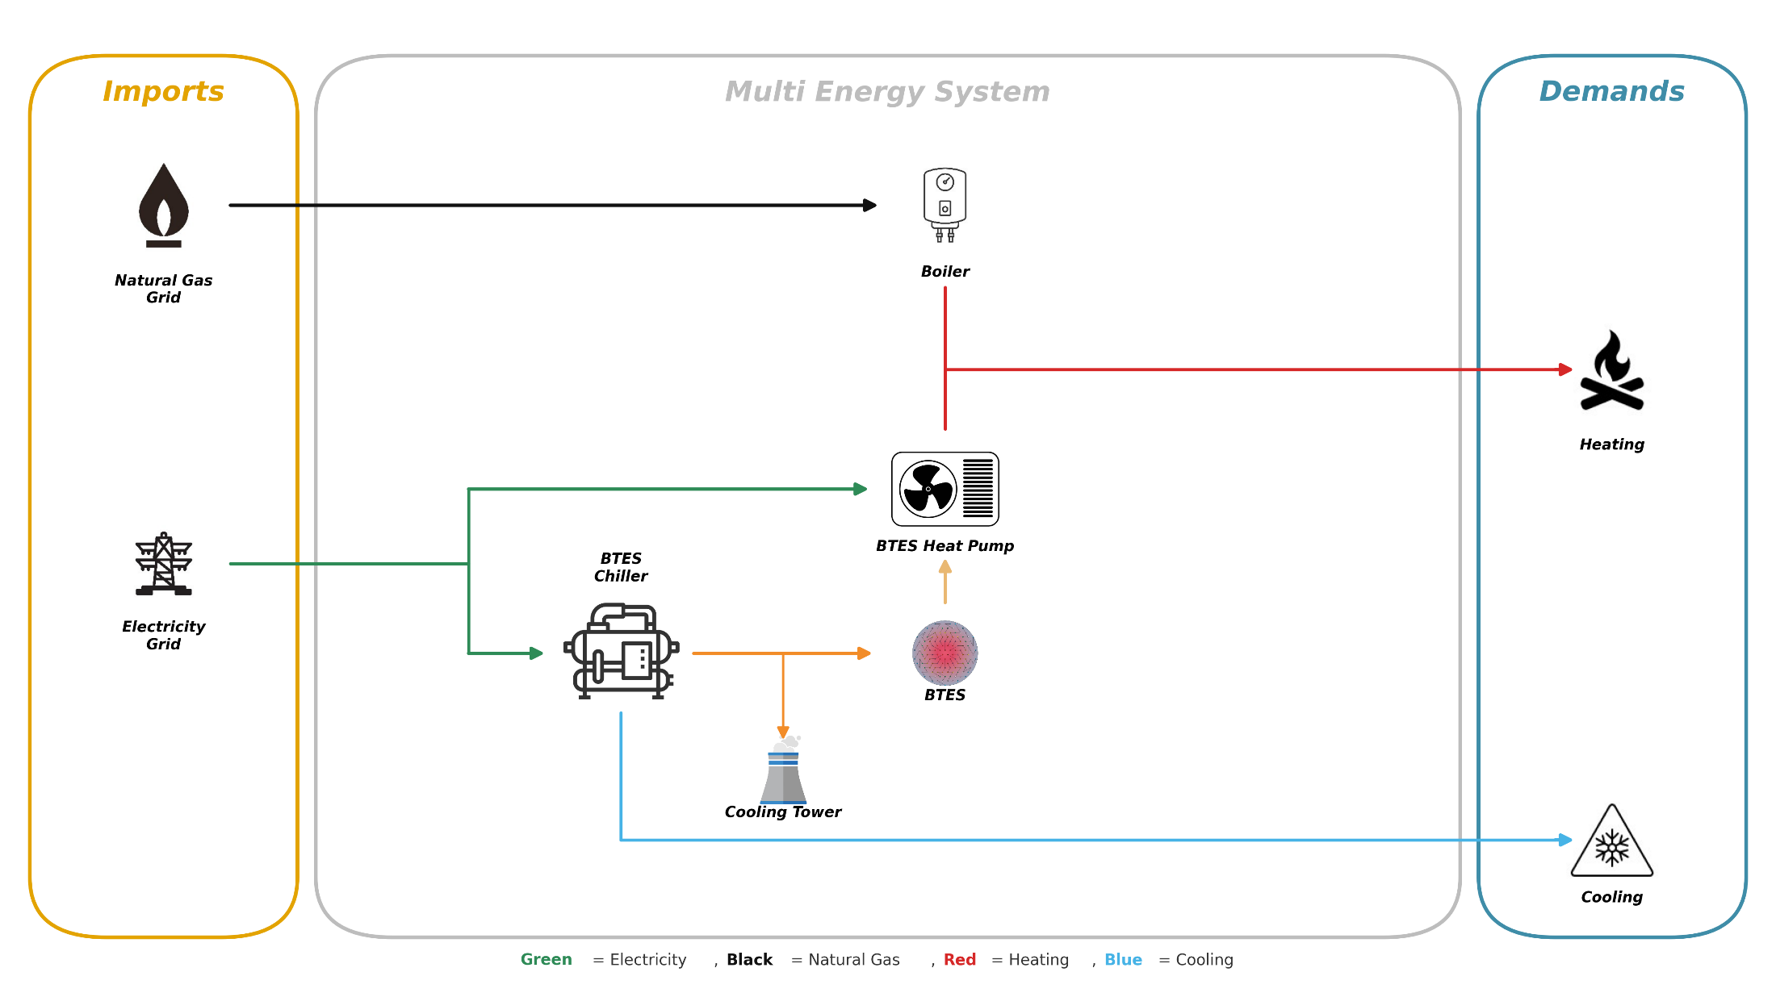
Methodology - Case Study
Definition
EMPA campus case study

Slide 8
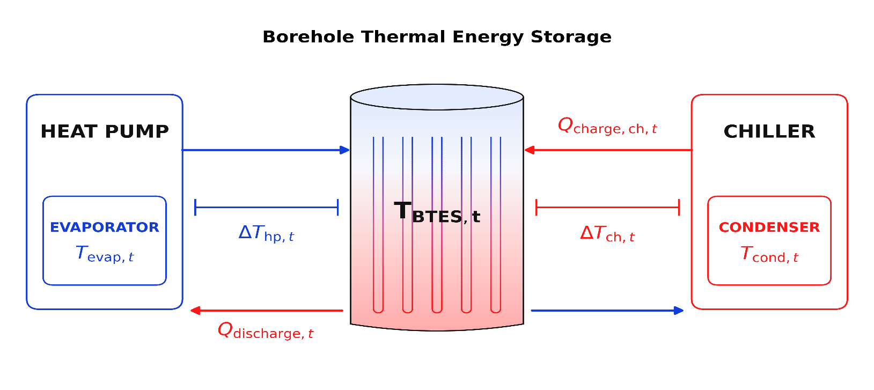

Methodology- Operational
Strategies
Note: All strategies tested using the MINLP model
$$\frac{1}{{COP}_{HP}}={α(Τ}_{btes}[t] − {ΔΤ}_{hp,btes}[t]) + β$$
$$\frac{1}{{COP}_{chiller}}={α(Τ}_{btes}[t] +{ΔΤ}_{chiller,btes}[t]) + β$$
Strategy I | Strategy II | Strategy III
ΔT as scalar decision variable | Tevap/Tcond as scalar decision variables | ΔT/Tevap/Tcond as varying decision variables
[11] Fiorentini, M. et al. (2023), Energy, 262, 125464.

Slide 9
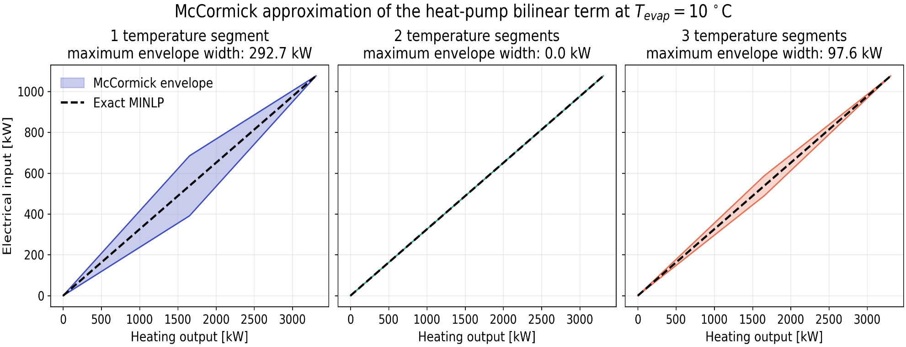
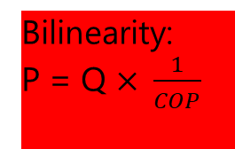
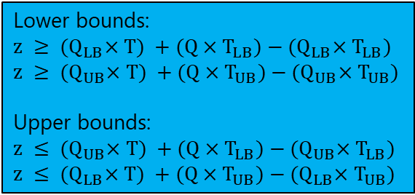
Methodology – McCormick relaxation - MILP
Lower bounds:
$z$ $≥ {(Q}_{LB}×T) +(Q×T_{LB})−{(Q}_{LB}×T_{LB})$
$z$ $≥ {(Q}_{UB}×T) +(Q×T_{UB})−{(Q}_{UB}×T_{UB})$
Upper bounds:
$z$ $≤ {(Q}_{UB}×T) +(Q×T_{LB})−{(Q}_{UB}×T_{LB})$
$z$ $≤ {(Q}_{LB}×T) +(Q×T_{UB})−{(Q}_{LB}×T_{UB})$
Bilinearity:
P = Q $× \frac{1}{COP}$
Notes:
Note for the 2 segments, the 3 segment is tighter than the 1 segment as it was expected but because the 2 segments constrains meet the bounds it approximates the curve better than the 3 segment one. But as a statement the more segments will tighten the envelope and therefore approximate the solution better. TevapE[-5,25]

Slide 10
Methodology - BTES options
Option | Diameter (m) | Depth (m) | Volume (m³) | UA (kW/K) | Boreholes
1 | 53.4 | 53.4 | 119,200 | 22.5 | 158
2 | 61.2 | 61.2 | 179,600 | 33.8 | 207
3 | 70.0 | 70.0 | 269,400 | 50.6 | 271
4 | 80.1 | 80.1 | 404,100 | 76.0 | 355
5 | 91.7 | 91.7 | 606,100 | 113.9 | 466
6 | — | — | — | — | —

Slide 11
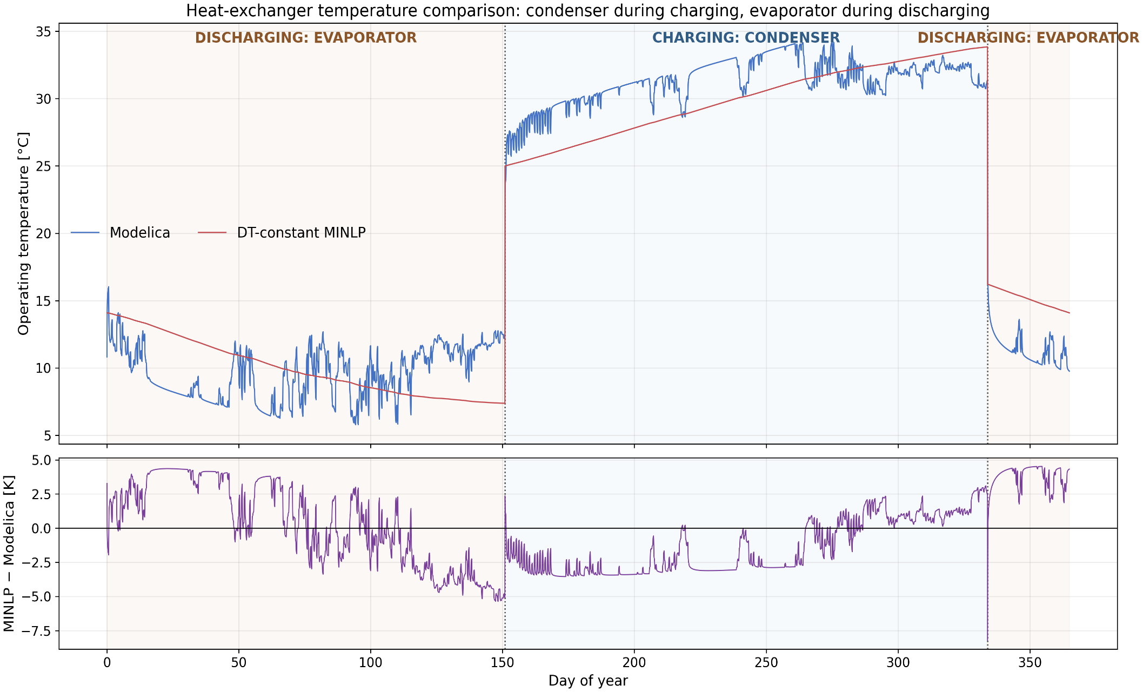
Results - Verification
Good agreement with Modelica (MAE = 2.51 K, RMSE = 2.84 K), supporting the MINLP for annual system-design optimization

Slide 12
Results – Impact of Operational Strategies
Technology | Strategy I (Scalar ΔT) | Strategy II (Scalar Tevap/Tcond) | Strategy III (Varying ΔΤ/Tevap/Tcond)
Heat Pump (kW) | 1019 | 1139 | 1227
Cooling Tower (kW) | 810 | 723 | 610
BTES | 4 | 4 | 4
Volume (m³) | 404,100 | 404,100 | 404,100
Annualized Cost (kCHF/a) | 987 | 995 | 968
Run time (s) | 42.99 | 42.63 | 37.11
Increasing operational flexibility changes technology sizing and reduces the annualized system cost by approximately 2.7%, while all strategies select the same BTES configuration
Notes:
Chiller is not an optimization problem and therefore is the same at all of them, and boiler is the same because it is being sized by the maximum heat demand during the charging period with the data and charging period selected.

Slide 13
Results - MILP simplifications/sizes
Quantity | MINLP | 3 seg. | 1 seg. | Fixed period | Fixed period/sizes | Fixed temp.
Speedup relative to MINLP | 1.00 | 0.41 | 0.70 | 1.32 | 1.11 | 10.67
Cost difference from MINLP | 0.00 | 6.11 | -1.15 | -0.88 | -0.88 | 6.23
Temperature RMSE [K] | 0.000 | 7.064 | 0.200 | 0.248 | 0.252 | 6.957

Slide 14
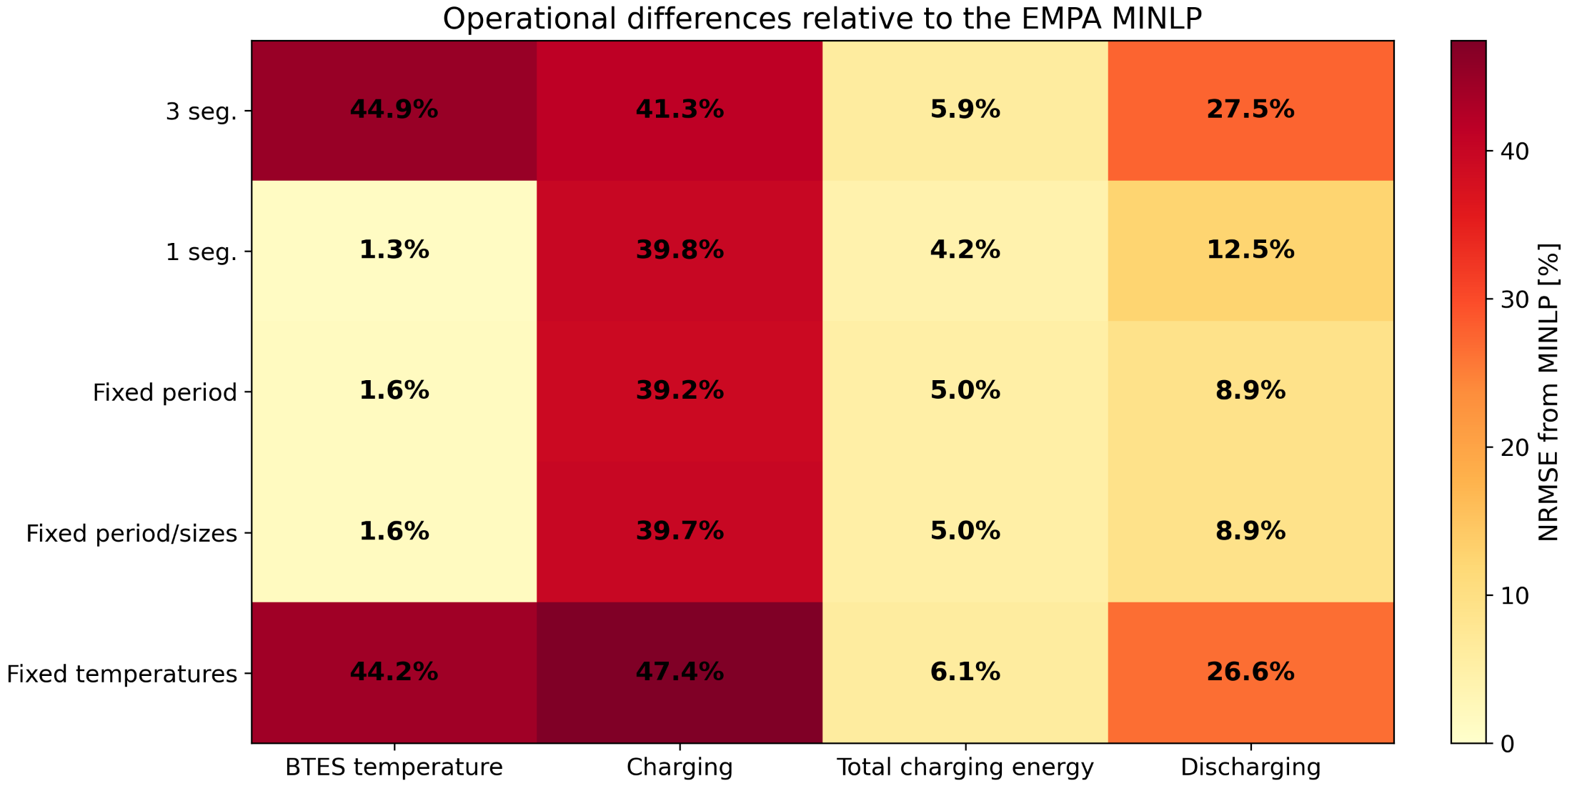
Results - MILP simplifications/operation

Slide 15
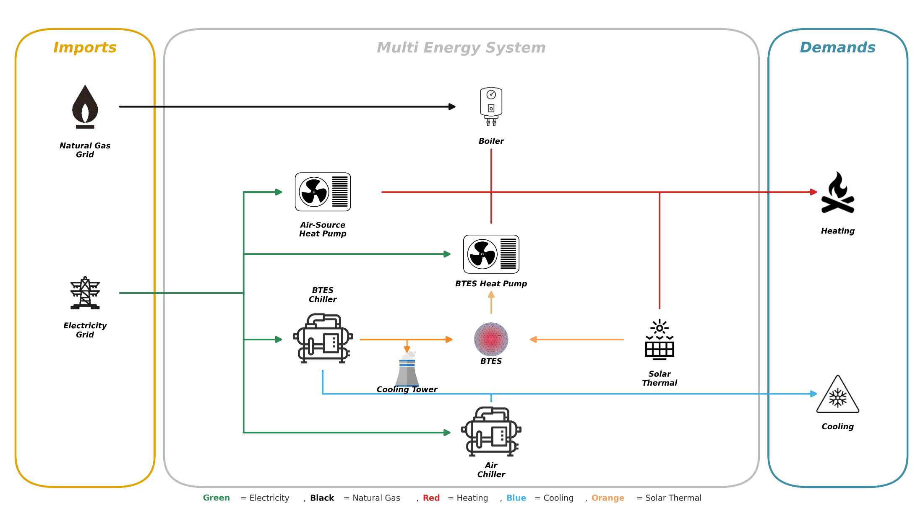
Extended Case Study Definition
General case study

Slide 16
Results - Extended Case Study
1 segment fixed period MILP used
1.45 speed foldup compared to the MINLP
Higher foldup that the simple case study
Increased system flexibility made the linearization even more attractive

Slide 17
Conclusions
Appropriate formulation depends on the intended application
Operational Strategies
Mathematical Formulation
Modelling simplifications
Increasing operational flexibility reduces the annual system cost by approximately 2.7%
The 3-segment MILP increased computational effort without improving agreement with the MINLP
The 1-segment fixed-period MILP provides the best compromise between accuracy and tractability
System Complexity
The computational advantage of the simplified MILP increases as system flexibility increases
The 1-segment MILP consistently reproduced the MINLP more closely than the original 3-segment MILP
Fixing the operating temperatures provides the largest speed-up but also the largest deviation from the MINLP
Notes:
The interaction between the discrete BTES design options and the geometry of the McCormick relaxation was found to play an equally important role in determining the final solution

Slide 18

Quote of the Day

Slide 19
Appendix

Slide 20
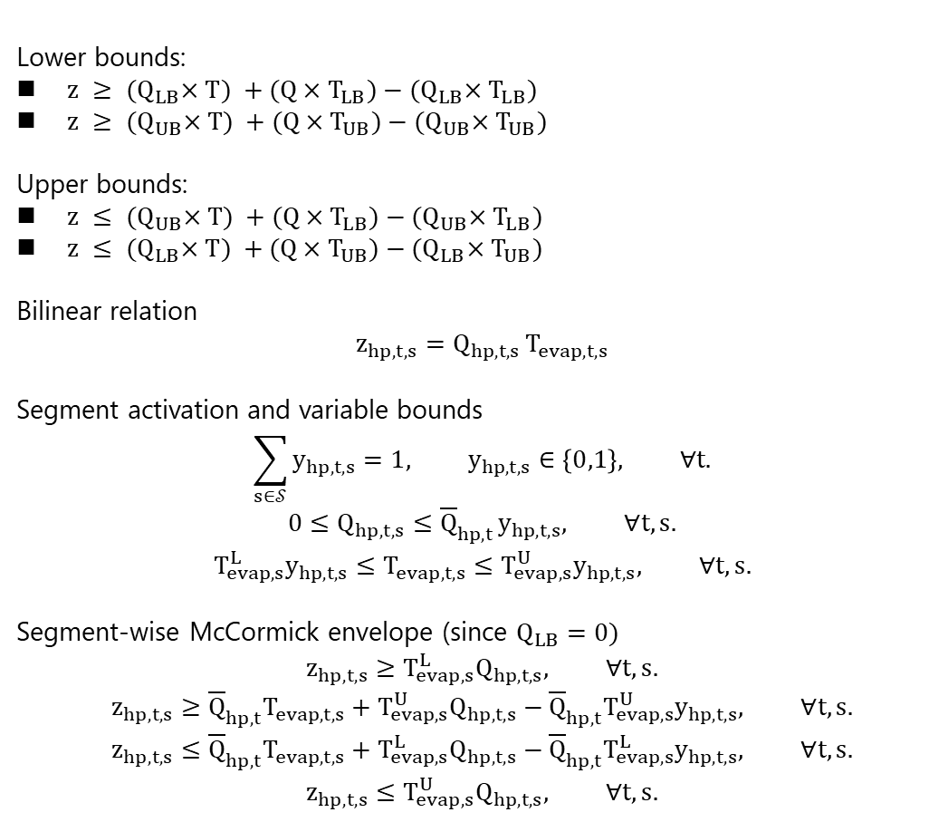
McCormick envelope¹²
Lower bounds:
$z$ $≥ {(Q}_{LB}×T) +(Q×T_{LB})−{(Q}_{LB}×T_{LB})$
$z$ $≥ {(Q}_{UB}×T) +(Q×T_{UB})−{(Q}_{UB}×T_{UB})$
Upper bounds:
$z$ $≤ {(Q}_{UB}×T) +(Q×T_{LB})−{(Q}_{UB}×T_{LB})$
$z$ $≤ {(Q}_{LB}×T) +(Q×T_{UB})−{(Q}_{LB}×T_{UB})$
Bilinear relation
$$z_{hp,t,s}=Q_{hp,t,s} T_{evap,t,s}$$
Segment activation and variable bounds
$$\sum_{s∈𝒮}{y_{hp,t,s}}=1, y_{hp,t,s}∈\left\{0,1\right\}, ∀t.$$
$$0≤Q_{hp,t,s}≤{\overline{Q}}_{hp,t} y_{hp,t,s}, ∀t,s.$$
$$T_{evap,s}^{L}y_{hp,t,s}≤T_{evap,t,s}≤T_{evap,s}^{U}y_{hp,t,s}, ∀t,s.$$
Segment-wise McCormick envelope (since $Q_{LB}=0)$
$$z_{hp,t,s}≥T_{evap,s}^{L}Q_{hp,t,s}, ∀t,s.$$
$$z_{hp,t,s}≥{\overline{Q}}_{hp,t}T_{evap,t,s}+T_{evap,s}^{U}Q_{hp,t,s}−{\overline{Q}}_{hp,t}T_{evap,s}^{U}y_{hp,t,s}, ∀t,s.$$
$$z_{hp,t,s}≤{\overline{Q}}_{hp,t}T_{evap,t,s}+T_{evap,s}^{L}Q_{hp,t,s}−{\overline{Q}}_{hp,t}T_{evap,s}^{L}y_{hp,t,s}, ∀t,s.$$
$$z_{hp,t,s}≤T_{evap,s}^{U}Q_{hp,t,s}, ∀t,s.$$
[12] McCormick envelopes - cornell university computational optimization open textbook- optimization wiki.

Slide 21
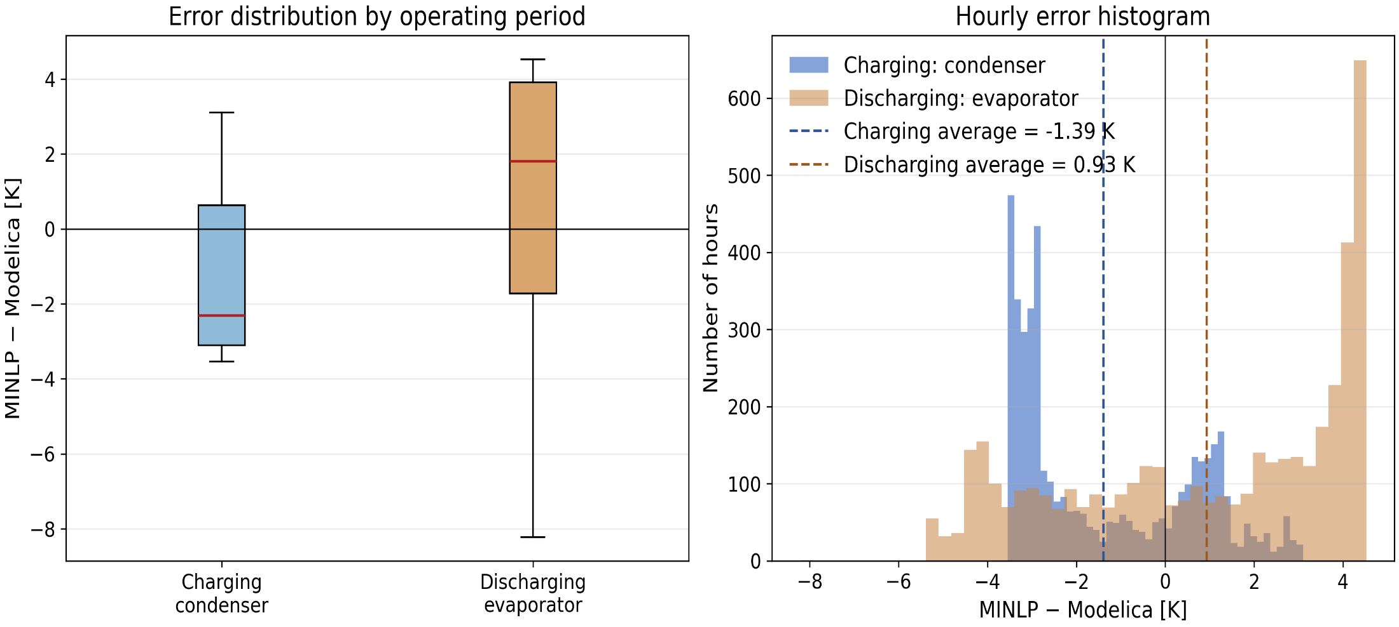
Verification

Slide 22
Verification
Quantity | Charging: condenser | Discharging: evaporator
Mean MINLP temperature [°C] | 29.926 | 10.868
Mean Modelica temperature [°C] | 31.315 | 9.936
Mean bias error [K] | -1.389 | 0.932
Median error [K] | -2.307 | 1.796
Mean absolute error [K] | 2.141 | 2.885
Root-mean-square error [K] | 2.406 | 3.217
Maximum absolute error [K] | 3.543 | 8.213

Slide 23
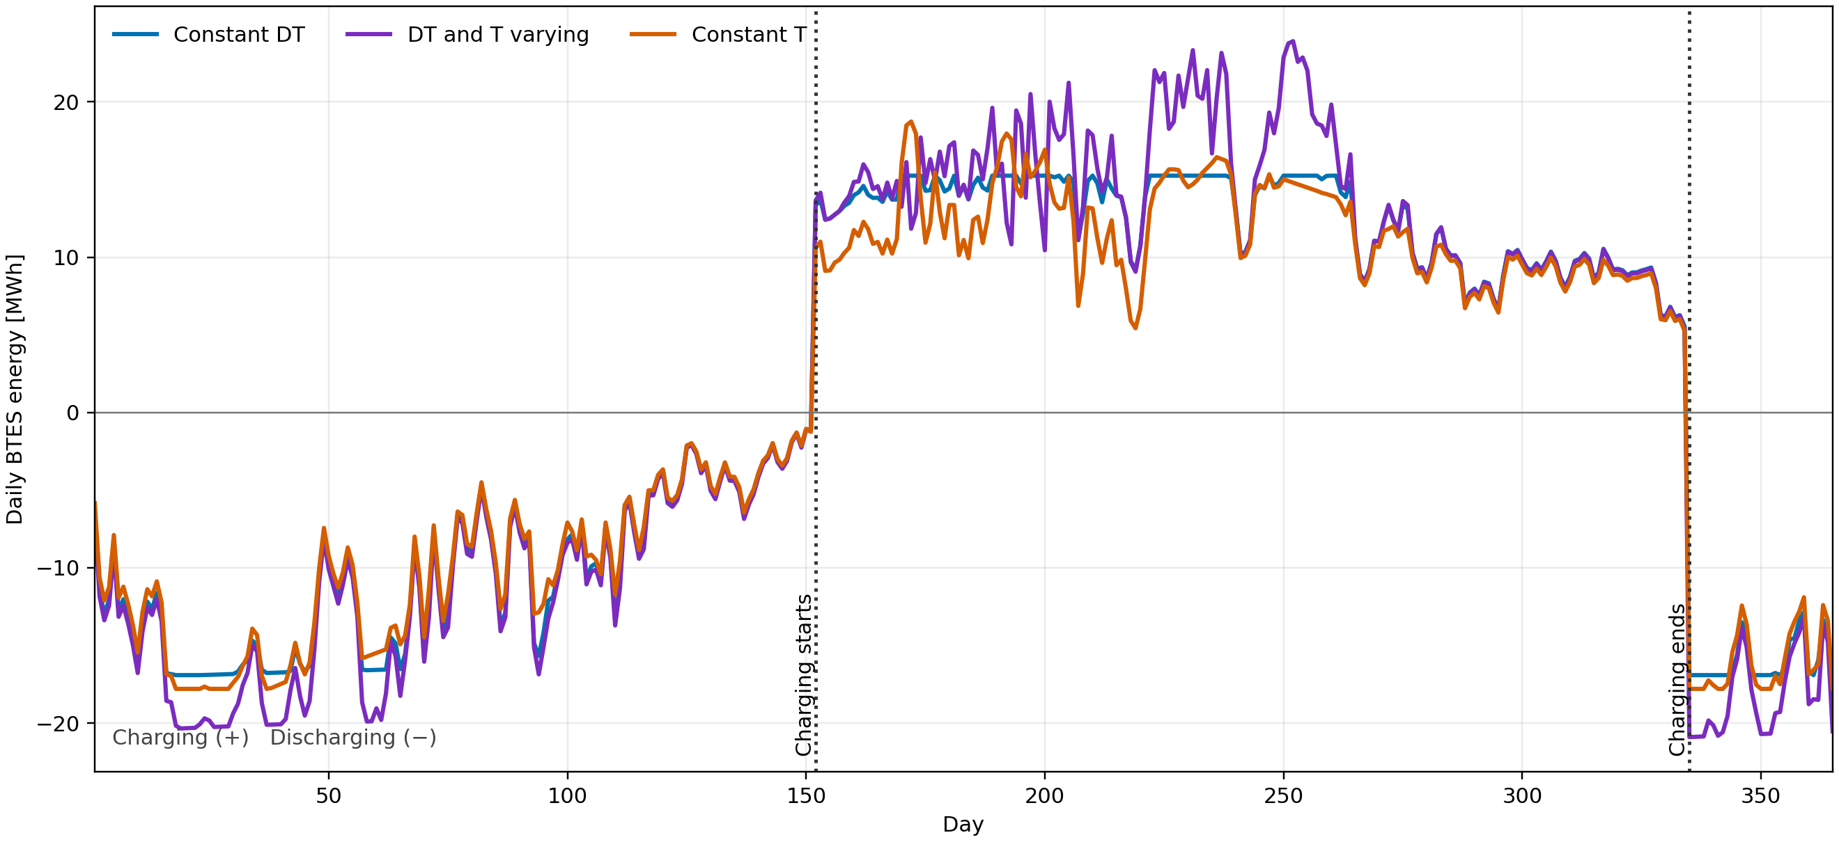
Operational Strategies
Notes:
Chiller is not an optimization problem and therefore is the same at all of them, and boiler is the same because it is being sized by the maximum heat demand during the charging period with the data and charging period selected.

Slide 24
Results - Mathematical
Formulations
Technology | MINLP | 3seg. MILP | Heuristic
Heat Pump (kW) | 1139 | 683 | 1341
Boiler (kW) | 1738 | 1589 | 2236
Cooling Tower (kW) | 723 | 624 | -
BTES | 4 | 5 | 4
Volume (m³) | 404,100 | 606,100 | 404,100
Annual Cost (kCHF) | 995 | 1056 | -
Bilinear Cnstrains | 17520 | - | -
Binary Variables | 26280 | 26286 | -
Run time (s) | 118 | 306 | 2
Linearization substantially increases the computational effort of the optimization problem
Notes:
Different charging period selected from the MILP and thus different boiler, also for the tractability and thus the computational complexity of the problem even though the bilinear constrains are removed the gurobi solver is able to solve much easier the non linear problem rather than the linear because of the 6 added constrains

Slide 25
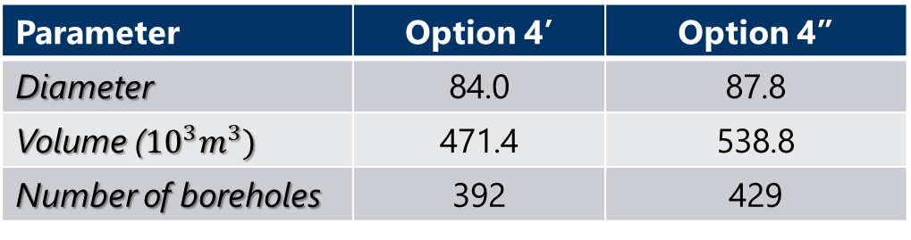
Interpolation of BTES options and 2 seg. MILP
Parameter | Option 4’ | Option 4’’
Diameter | 84.0 | 87.8
Volume (${10}^{3}m^{3})$ | 471.4 | 538.8
Number of boreholes | 392 | 429
The relaxation of the McCormick envelope in this case lies closer to the optimal solution because of the different relaxation bounds
Technology | MINLP | Interpolated MILP | 2 seg. MILP
Heat Pump (kW) | 1139 | 1220 | 1084
Boiler (kW) | 1738 | 1738 | 1589
Cooling Tower (kW) | 723 | 610 | 725
BTES | 4 | 4’’ | 4
Volume (m³) | 404,100 | 471,400 | 404,100
Annual Cost (kCHF) | 995 | 999 | 987
Run time (s) | 118 | 282 | 183
Notes:
Continouing the mathematical model comparison we add 2 more discrete sizes and also we test the 2 seg. Model

Slide 26
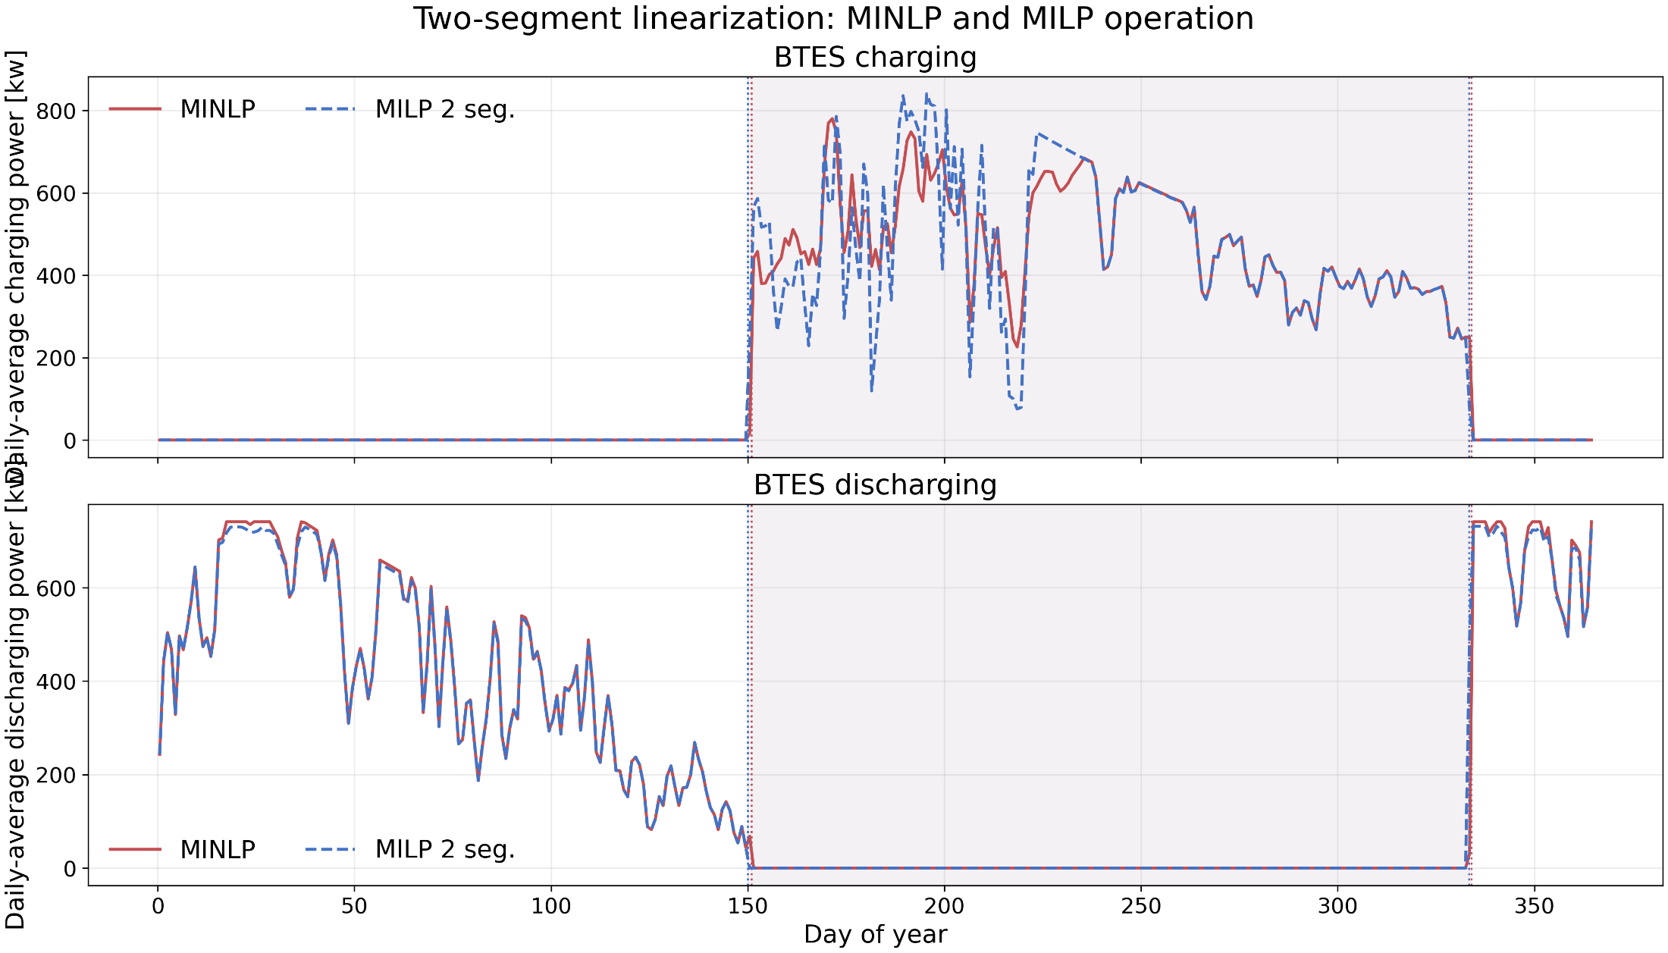

Slide 27
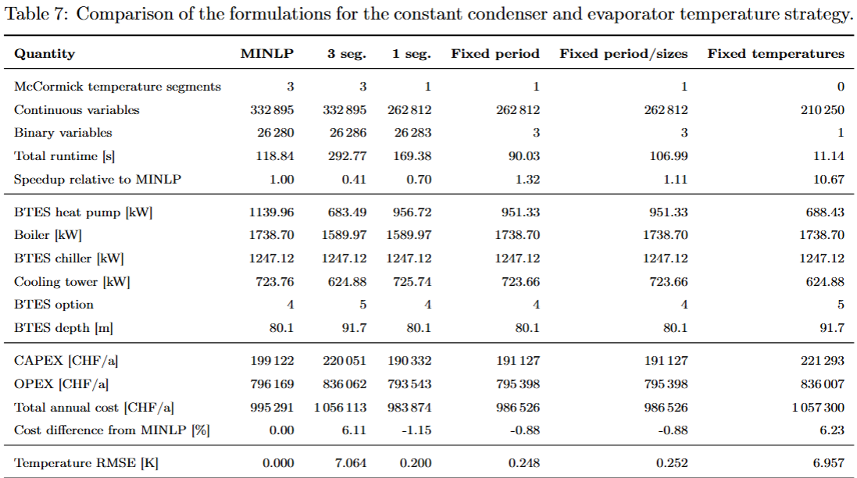
Results - MILP simplifications/sizes

Slide 28
Extended Case Study
Technology | MINLP | 1 seg. MILP | |MILP-MINLP| [%]
BTES Heat Pump (kW) | 297 | 326 | 10.11
Boiler (kW) | 875 | 866 | 1.04
Cooling Tower (kW) | 829 | 830 | 0.06
ASHP (kW) | 1064 | 1043 | 1.97
Air Chiller (kW) | 356 | 356 | 0.00
BTES | 1 | 1 | -
Volume (m³) | 179,600 | 179,600 | -
Annual Cost (kCHF) | 825 | 802 | 3.44
Run time (s) | 366 | 253 | 30.91

Slide 29
Heuristic Model
Provides a simple, non-optimization baseline for sizing the borehole thermal energy storage (BTES).
Stores the smaller of the available summer waste heat and winter heating demand.
Selects the smallest BTES design capable of storing the required energy.
Simulates daily charging, discharging, thermal losses, and BTES temperature.
Notes:
Note for the 2 segments, the 3 segment is tighter than the 1 segment as it was expected but because the 2 segments constrains meet the bounds it approximates the curve better than the 3 segment one. But as a statement the more segments will tighten the envelope and therefore approximate the solution better.

Slide 30
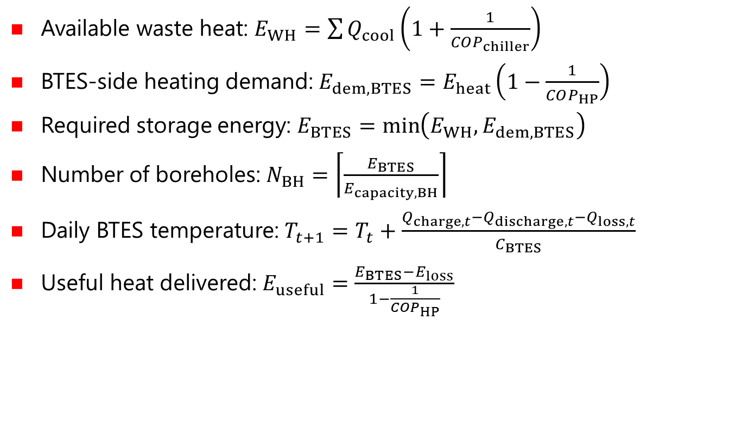
Steady State Heuristic^{13,14}
Available waste heat: $E_{WH}=\sum{Q_{cool}}\left(1+\frac{1}{COP_{chiller}}\right)$
BTES-side heating demand: $E_{dem,BTES}=E_{heat}\left(1−\frac{1}{COP_{HP}}\right)$
Required storage energy: $E_{BTES}=\min\left(E_{WH},E_{dem,BTES}\right)$
Number of boreholes: $N_{BH}=\left\lceil \frac{E_{BTES}}{E_{capacity,BH}}\right\rceil$
Daily BTES temperature: $T_{t+1}=T_{t}+\frac{Q_{charge,t}−Q_{discharge,t}−Q_{loss,t}}{C_{BTES}}$
Useful heat delivered: $E_{useful}=\frac{E_{BTES}−E_{loss}}{1−\frac{1}{COP_{HP}}}$
[13] Tom Lambert, Paul Gilman, and Peter Lilienthal. Micropower system modeling withhomer. In Felix A. Farret and M. Godoy Simões, editors, Integration of AlternativeSources of Energy
[14] Z. Wang, J. Crawley, F. G. N. Li, and R. Lowe. Sizing of district heating systemsbased on smart meter data: Quantifying the aggregated domestic energy demandand demand diversity in the UK.
Notes:
Available waste heat: $E_{WH}=\sum{Q_{cool}}\left(1+\frac{1}{COP_{chiller}}\right)$, Calculates the heat available for BTES charging during summer.
BTES-side heating demand: $E_{dem,BTES}=E_{heat}\left(1−\frac{1}{COP_{HP}}\right)$, Converts winter heating demand into the required heat extraction from the BTES.
Required storage energy: $E_{BTES}=\min\left(E_{WH},E_{dem,BTES}\right)$, Sets the storage size based on the limiting energy quantity.
Number of boreholes: $N_{BH}=\left\lceil \frac{E_{BTES}}{E_{capacity,BH}}\right\rceil$, Estimates the required number of boreholes
Daily BTES temperature: $T_{t+1}=T_{t}+\frac{Q_{charge,t}−Q_{discharge,t}−Q_{loss,t}}{C_{BTES}}$
Useful heat delivered: $E_{useful}=\frac{E_{BTES}−E_{loss}}{1−\frac{1}{COP_{HP}}}$, Calculates the final building heat supplied after storage losses.

Slide 31
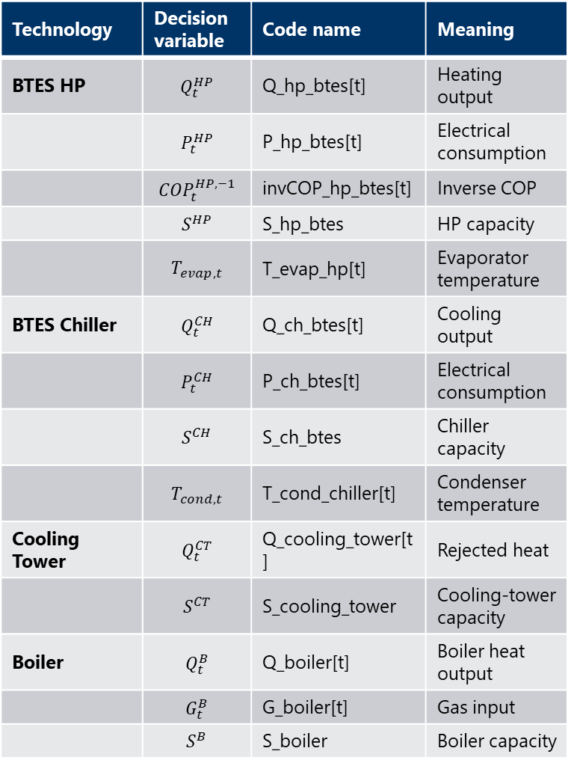
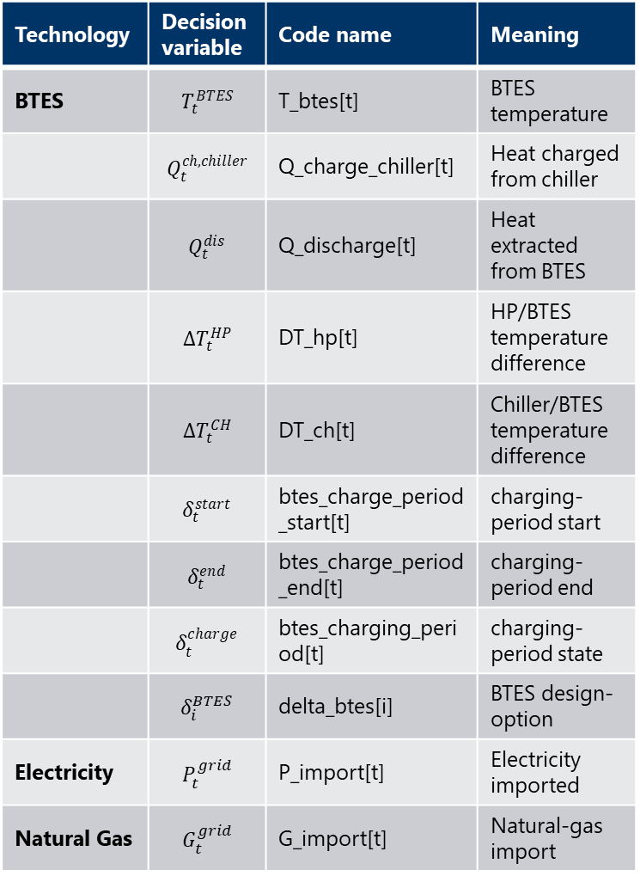
Decision Vairables
Technology | Decision variable | Code name | Meaning
BTES | $$T_{t}^{BTES}$$ | T_btes[t] | BTES temperature
 | $$Q_{t}^{ch,chiller}$$ | Q_charge_chiller[t] | Heat charged from chiller
 | $$Q_{t}^{dis}$$ | Q_discharge[t] | Heat extracted from BTES
 | $$ΔT_{t}^{HP}$$ | DT_hp[t] | HP/BTES temperature difference
 | $$ΔT_{t}^{CH}$$ | DT_ch[t] | Chiller/BTES temperature difference
 | $$δ_{t}^{start}$$ | btes_charge_period_start[t] | charging-period start
 | $$δ_{t}^{end}$$ | btes_charge_period_end[t] | charging-period end
 | $$δ_{t}^{charge}$$ | btes_charging_period[t] | charging-period state
 | $$δ_{i}^{BTES}$$ | delta_btes[i] | BTES design-option
Electricity | $$P_{t}^{grid}$$ | P_import[t] | Electricity imported
Natural Gas | $$G_{t}^{grid}$$ | G_import[t] | Natural-gas import
Technology | Decision variable | Code name | Meaning
BTES HP | $$Q_{t}^{HP}$$ | Q_hp_btes[t] | Heating output
 | $$P_{t}^{HP}$$ | P_hp_btes[t] | Electrical consumption
 | $$COP_{t}^{HP,−1}$$ | invCOP_hp_btes[t] | Inverse COP
 | $$S^{HP}$$ | S_hp_btes | HP capacity
 | $$T_{evap,t}$$ | T_evap_hp[t] | Evaporator temperature
BTES Chiller | $$Q_{t}^{CH}$$ | Q_ch_btes[t] | Cooling output
 | $$P_{t}^{CH}$$ | P_ch_btes[t] | Electrical consumption
 | $$S^{CH}$$ | S_ch_btes | Chiller capacity
 | $$T_{cond,t}$$ | T_cond_chiller[t] | Condenser temperature
Cooling Tower | $$Q_{t}^{CT}$$ | Q_cooling_tower[t] | Rejected heat
 | $$S^{CT}$$ | S_cooling_tower | Cooling-tower capacity
Boiler | $$Q_{t}^{B}$$ | Q_boiler[t] | Boiler heat output
 | $$G_{t}^{B}$$ | G_boiler[t] | Gas input
 | $$S^{B}$$ | S_boiler | Boiler capacity

